Slide 1


Hybrid Cloud Connectivity: Phase 1
Design, IP Plan, and Dashboard Metrics for VPN

Slide 2




Connecting Two Worlds: On-Premise & Cloud VPC
Our scenario involves establishing secure connectivity between two distinct network environments:
On-Premise Network
Cloud VPC Network
Located at the "Left Site", this traditional network uses the IP range 192.168.1.0/24.
The "Right Site" leverages a Cloud Virtual Private Cloud, operating on the IP range 192.168.2.0/24.
The ultimate goal is to create a robust, secure VPN tunnel, linking these environments via a Router0 → Router2 → Router1 topology, enabling seamless and protected data exchange.

Slide 3

Phase 1 Objectives: Laying the Foundation
Phase 1 focuses on the critical design and planning stages, ensuring a solid blueprint for implementation.
1
2
VPN Topology Design
IP Schema Preparation
Defining the architecture for secure, encrypted communication pathways.
Allocating and documenting all IP addresses for devices and interfaces across both sites.
3
4
Routing Design
Dashboard Metrics
Crafting the rules that dictate how network traffic will flow between on-premise and cloud resources.
Identifying key performance indicators for monitoring VPN health, including tunnel uptime, latency, and throughput.

Slide 4
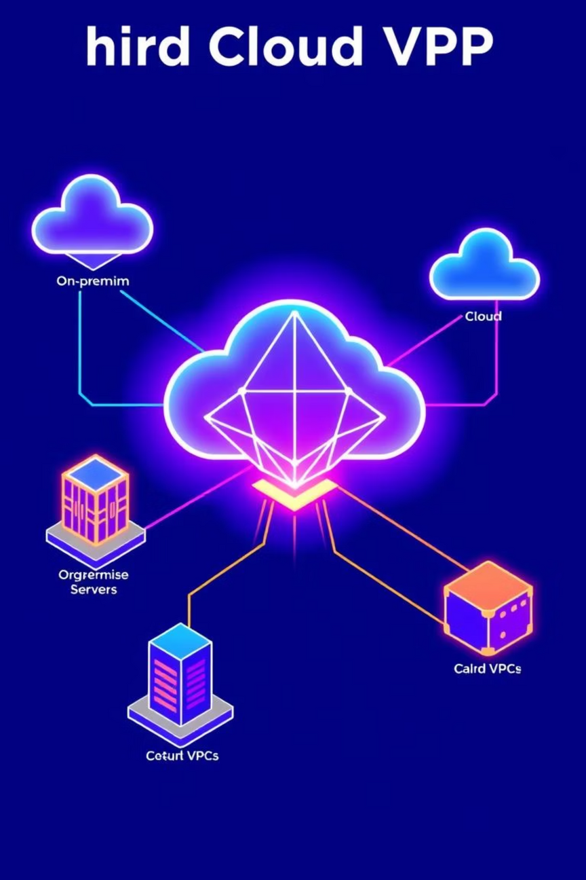
Network Topology: A Detailed Overview
Our hybrid cloud architecture, as envisioned in the Packet Tracer file, comprises three key segments:
On-Premise Site (Left)
Cloud Site (Right)
VPN Hub Router (Middle)
PC0: 192.168.1.2
PC1: 192.168.2.2
Router0 (LAN): 192.168.1.1
Router1 (LAN): 192.168.2.1
Router2 (towards On-Prem): 1.0.0.1
Router0 (WAN link to Router2): 1.0.0.2
Router1 (WAN link to Router2): 2.0.0.2
Router2 (towards Cloud): 2.0.0.1
Router2 acts as our central VPN gateway, facilitating secure communication between both distinct environments.

Slide 5
Phase 1: Defining the VPN Tunnel Design
The core of our secure connectivity relies on a meticulously designed IPsec VPN tunnel. This is how it works:
Mode: Site-to-Site
IKE Phase 1 (ISAKMP)
Ensuring continuous, secure connection between the two specified network locations.
Key exchange parameters: AES-256 encryption, SHA-256 hashing, DH Group 14.
IKE Phase 2 (IPsec)
Authentication
Data encryption with AES-256, ESP protocol, and PFS enabled.
Secure validation using a Pre-Shared Key (PSK) for mutual trust.
The VPN tunnel will encrypt all traffic originating from 192.168.1.0/24 destined for 192.168.2.0/24, ensuring data integrity and confidentiality.

Slide 6
Phase 1: Comprehensive IP Addressing Plan
A detailed IP plan is crucial for seamless network operation, as derived from our lab setup:
PC0
NIC
192.168.1.2
Router0
LAN
192.168.1.1
Router0
WAN
1.0.0.2
PC1
NIC
192.168.2.2
Router1
LAN
192.168.2.1
Router1
WAN
2.0.0.2
Router2
Towards Router0
1.0.0.1
Router2
Towards Router1
2.0.0.1
This table details every device and interface, providing a clear map for network configuration.

Slide 7



Phase 1: Strategic Routing Plan
Effective routing ensures all traffic traverses the secure VPN hub, maintaining data privacy and integrity.
On-Prem Router (Router0)
Cloud Router (Router1)
Router2 (VPN Gateway)
A defined route to the cloud network (192.168.2.0/24) is configured, with 1.0.0.1 as its next-hop.
A corresponding route to the on-premise network (192.168.1.0/24) is set, pointing to 2.0.0.1 as its next-hop.
This central router inherently understands both networks through its direct connections, acting as the critical VPN hub.
This configuration forces all cross-site communication through the encrypted VPN tunnel, centralizing security.

Slide 8
Phase 1: Essential Dashboard Metrics
While implementation is in Phase 2, defining monitoring metrics now ensures we can assess VPN performance effectively.
Tunnel Uptime
Crucial for monitoring the VPN's operational status, detecting any disruptions or rekeying events.
Latency (Ping RTT)
Measures the Round-Trip Time, indicating network delay and helping to identify potential congestion.
Throughput (Bandwidth)
Tracks the volume of encrypted data flowing in and out of the VPN tunnel, ensuring adequate bandwidth.
Packet Loss
Monitors the reliability and stability of the tunnel, identifying any dropped packets that could impact performance.
Critical Alerts
Tunnel Down Alert
High Latency Alert
Bandwidth Spike Alert

Slide 9




Dashboard Tools: Future Considerations (Phase 2)
In Phase 1, our focus remains on defining what to monitor. The selection and setup of these tools will occur in Phase 2.
These are examples of robust monitoring platforms that can provide comprehensive visibility into VPN performance. For now, the design of the monitoring strategy is complete.

Slide 10
Phase 1 Conclusion: Ready for Implementation
Phase 1 of our Hybrid Cloud Connectivity project has successfully established a detailed and actionable plan.
01
02
VPN Layout Designed
Full IP Addressing Plan
A complete VPN architecture has been meticulously planned, utilizing the specified topology.
All necessary IP addresses for devices and interfaces have been precisely mapped out.
03
04
Routing Plan Prepared
Monitoring Metrics Defined
The strategic flow of network traffic has been defined, ensuring secure passage through the VPN hub.
Key performance indicators like latency, uptime, and throughput have been established for future monitoring.
With Phase 1 complete, we have a robust framework ready for the secure implementation of our hybrid cloud VPN in Phase 2.

